Slide 1
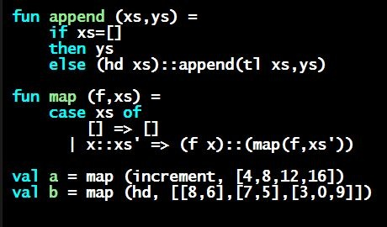
Programming Languages Dan Grossman University of Washington
[Placeholder for] Course Motivation

Slide 2
What this course is about
Many essential concepts relevant in any programming language
And how these pieces fit together
Use ML, Racket, and Ruby languages:
They let many of the concepts “shine”
Using multiple languages shows how the same concept can “look different” or actually be slightly different
In many ways simpler than Java, C#, Python, …
Big focus on functional programming
Not using mutation (assignment statements) (!)
Using first-class functions (can’t explain that yet)
But many other topics too

Slide 3
Why learn this?
This is the “normal” place for course motivation
Why learn this material?
But in my experience, we don’t have enough shared vocabulary
So delay full motivation until after function closures (Section 3)
(Will motivate immutable data at end of section 1)
In the meantime, have to “assert things” without much evidence
Except lots of prior students
Example feedback: “I had tried to learn _____ several times before. But after your course, I had no trouble working through the tutorials quickly…”

Slide 4
My claim
Learning to think about software in this “PL” way will make you a better programmer even if/when you go back to old ways
It will also give you the mental tools and experience you need for a lifetime of confidently picking up new languages and ideas
[Somewhat in the style of The Karate Kid movies (1984, 2010)
http://www.imdb.com/title/tt0087538/
http://www.imdb.com/title/tt1155076/
]

Slide 5
A strange environment
Next 4-5 weeks will use
ML language
Emacs editor
Read-eval-print-loop (REPL) for evaluating programs
Need to get things installed and configured
See written instructions (read carefully; feedback welcome)
Optional: videos showing Windows installation
Only then can you focus on the “real content” and Homework 1
Working in strange environments is a computing life skill

Slide 6
Not about the languages
Cannot emphasize enough that ML (Part A), Racket (Part B), and Ruby (Part C) are “means to other ends”
Chosen as “particularly good fits for the topics”
Other choices possible
Also readily admit ML in particular no longer used-much-for-real
Closely related languages are: OCaml, F#, Scala, Haskell
Arguably a feature and not a bug:
Nobody distracted by “already knowing it”
More effective for “Karate Kid” approach
Focus on core features, not libraries, fancy stuff, etc.
A very “clean, compositional, elegant” language

Slide 7
Enough text already
Non-introductory lectures will write code
Plus switch to slides for key concepts
Plus “in-video questions”
Much better than these “introduction” videos
So forgive the “boring intro stuff”

